Slide 1

DATA VISUALIZATION
UNIT-V

Slide 2
CONTENT :Introduction to visualization tool
Evaluate the data
visualize Model’s Analytical Results:
Hidden grouping
Data classification results
Outliers
Decision trees
Prediction
Novel visualization in Predictive Analytics.

Slide 3
GOAL
Applying
Applying visualization to the predictive analytics lifecycle
Evaluating
Evaluating data visualization
Using
Using visualization on different predictive analytics models

Slide 4

VISUALIZING HIGH DIMENSIONAL DATA
https://youtu.be/wvsE8jm1GzE?si=xRkVTKY7OWKxXYjZ

Slide 5
Data Visualization in Predictive Analytics:
1. Introduction to Visualization:
Visualization is an art that involves analyzing data to tell a compelling story using analytical results.
It's not just about the present or past but also about foreseeing the future.
Quick, easy-to-generate visualizations aid in faster and more effective decision-making.
Executives benefit from data visualization by asking better questions about the organization.
2. Importance, Benefits, and Complexity:
evaluating visualizations with four criteria and understanding different visualization types for various prediction models.
It emphasizes using data visualization to interpret analytical results and report back to business stakeholders.
3. Visualization as a Predictive Tool:
Napoleon Bonaparte's quote highlights the efficacy of visuals in communication.
Throughout history, pictorial representations like maps have been crucial in sharing information.
In predictive analytics, data visualization presents analytical outcomes pictorially, facilitating realistic and actionable narratives for potential futures, aiding organizational strategies.

Slide 6
Why Visualization Matters
Compared to sifting through spreadsheets and reports, graphs offer a quicker and more comprehensible way to convey information.
Visualization tools empower analysts to derive deeper insights, respond faster to risks, and present findings in user-friendly ways to executives.
They help convert raw content (e.g., text) into clear pictorial representations, saving time and effort

Slide 7
Efficiency, Advantages, and Challenges
Interactive Data Visualization:
Interactive visualization allows for deeper analysis by enabling drilling down into data represented in graphs and charts.
It permits dynamic changes in data, selection of different predictive models, and preprocessing techniques, saving analysts significant time in generating reports and effective communication.
Benefits of Visualization:
Using visualizations saves time in conveying ideas to management, instantly clarifying complex analytical results.
Charts and graphs ease decision-making processes by identifying areas needing attention and aiding in predicting trends.
Complexities of Visualization:
While powerful, effective visualization requires multidisciplinary skills in statistics, analysis, design, programming, and narrative creation.
Handling large, diverse data sets for meaningful representation can be challenging.
Visualizations can inadvertently convey misleading patterns or predictions, requiring careful interpretation and consensus among analysts before presenting to management.

Slide 8
Evaluating Your Visualization
Relevance of Visualization:
Purposeful Data Presentation: A good visualization serves a clear purpose, aligning with the primary goal of the analytics project.
Narrative Development: It should construct a narrative around relevant data, emphasizing results and utilizing suitable visualization methods (e.g., PowerPoint for company presentations).
Interpretability of Visuals:
Deriving Meaningful Interpretations: Effective visualizations allow for distinct and unambiguous interpretations, leading to insights aligned with the model's output and business queries.
Convergence of Interpretations: Multiple interpretations should converge, supporting a coherent storyline or overarching concept, ensuring clarity.

Slide 9
Evaluating Your Visualization
Simplicity in Visualization:
Clarity and Elegance: Overly complex visualizations can mislead or confuse; clarity is achieved by incorporating clear legends explaining symbols, figures, and data components.
Medium Selection: Choosing the right medium, such as images, graphs, and charts, along with appropriate visual aids (TV screens, whiteboards), contributes to elegance and simplicity.
Insight Generation:
Unveiling New Insights: Visualization in predictive analytics aids in uncovering previously unknown insights, refining model outputs, and revealing hidden relationships within vast datasets.
Validation of Findings: Effective visualization should confirm and support analysis findings, facilitating easy comprehension and action by management.

Slide 10

Visualizing Your Model’s Analytical Results

Slide 11
Visualizing hidden groupings in your data
Data clustering is the process of discovering hidden groups of related items within your data.
A cluster (grouping) consists of data objects of the same type such as social network users, text documents, or e-mails.
One way to visualize the results of a data-clustering model is shown in Figure 11-1:
where the graph represents social communities (clusters) that were discovered in data collected from social network users.
In Figure 11-1, the data about customers was collected in a tabular format
Then a clustering algorithm was applied to the data, and the three clusters (groups) were discovered:
loyal customers
wandering customers
discount customers.
Here the visual relationship among the three groups already suggests where enhanced marketing efforts might do the best.

Slide 12
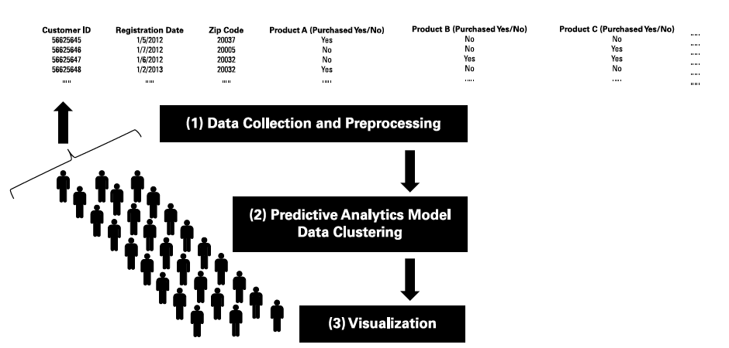
Visualizing hidden groupings in your data

Slide 13
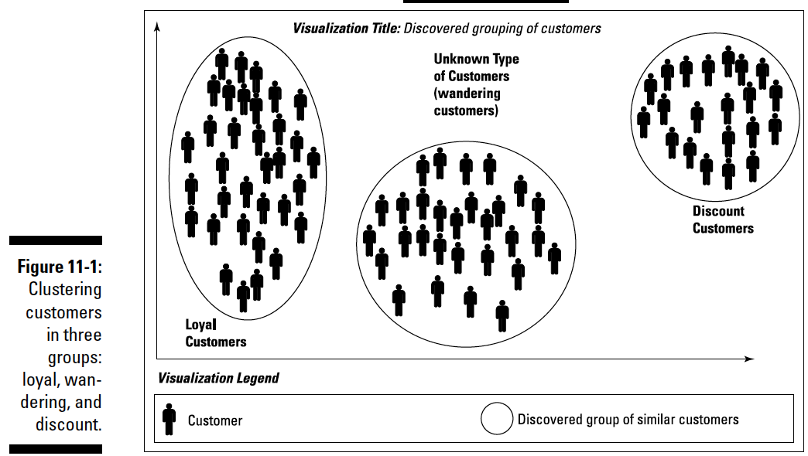

Slide 14

Visualizing data classification results

Slide 15
Visualizing data classification results
A classification model assigns a specific class to each new data point it examines.
The specific classes, in this case, could be the groups that result from your clustering work/
The output highlighted in the graph (refer to Figure 11-1) can define your target sets.
For any given new customer, a predictive classification model attempts to predict which group the new customer will belong to.
After you’ve applied a clustering algorithm and discovered groupings in the customer data :
When a new customer arrives — you want the model to predict which type of customer he or she will be.
Figure 11-2 shows how a new customer’s information is fed to your predictive analytics model, which in turn predicts which group of customers this new customer belongs to.
In Figure 11-2, new Customers A, B, and C are about to be assigned to clusters according the classification model.
Applying the classification model resulted in a prediction that Customer A would belong with the loyal customers, Customer B would be a wanderer, and Customer C was only showing up for the discount.

Slide 16
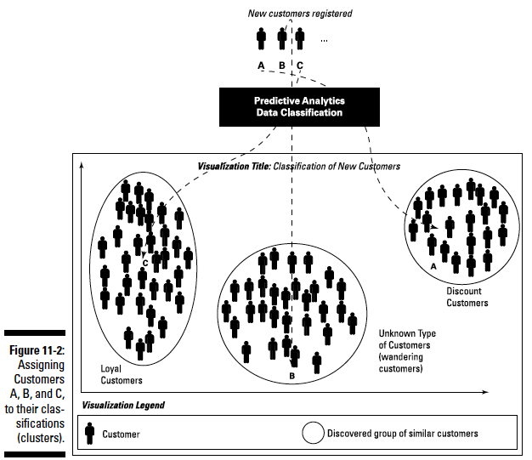

Slide 17
Visualizing outliers in your data
Figure 11-3 shows a few outliers that don’t fit well into the predefined clusters.
In Figure 11-3, six outlier customers have been detected and visualized.
They behave differently enough that the model can’t tell whether they belong to any of defined categories of customers
“Is there such a thing as, say, a loyal wandering customer who’s only interested in the discount? And if there is, should your business care?

Slide 18
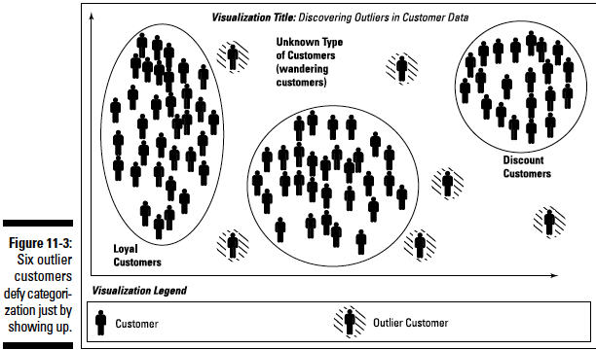

Slide 19
Visualization of Decision Trees
Figure 11-4 shows an example of a decision tree used as a classifier:
It classifies baseball fans based on a few criteria, mainly the amount spent on tickets and the purchase dates.
From this visualization, you can predict the type of fan that a new ticket-buyer will be:
Casual
Loyal
Bandwagon
Diehard or some other type.
Attributes of each fan are mentioned at each level in the tree (total number of attended games, total amount spent, season)
you can follow a path from a particular “root” to a specific “leaf” on the tree, where you hit one of the fan classes (c1, c2, c3, c4, c5).

Slide 20
Visualization of Decision Trees
Suppose we want to determine the type of baseball fan a customer is so that we can determine what type of marketing ads to send to the customer.
We want to know whether the customer is a baseball fanatic or someone who just rides the bandwagon.
Suppose we hypothesize that baseball fanatics and bandwagon fans can be persuaded to buy a new car (or other discretionary goods) when their team is doing well and headed for the playoffs.
We may want to send them marketing ads and discounts to persuade them to make the purchase.
Further, suppose we hypothesize that bandwagon fans can be persuaded to vote in support of certain political issues.
We can send them marketing ads asking them for that support.
If you know what type of fan base you have, using decision trees can help you decide how to approach it as a range of customer types.

Slide 21
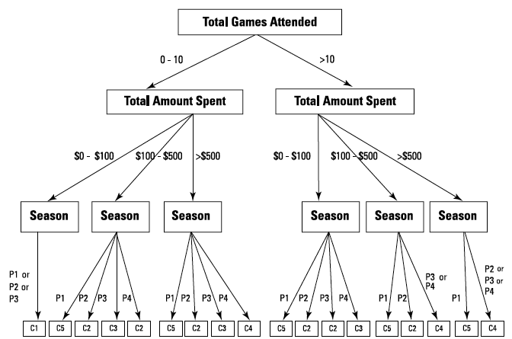
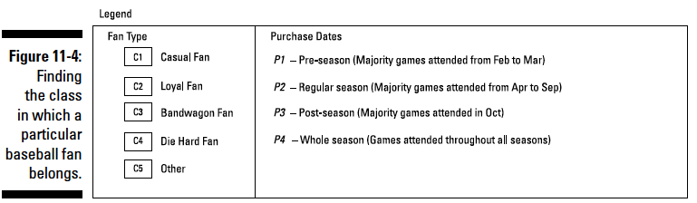
Visualization of Decision Trees

Slide 22
Visualizing Predictive Analytics Models
Prediction Models Employed: Decision Trees, Random Forests, and Flocking Algorithms
Visualization Technique: Figure 11-5
Components:
Confidence Score: A numerical percentage indicating the probability of occurrence
Supporting Evidence: Represented on the x-axis as content sources analyzed by content-analytics models

Slide 23
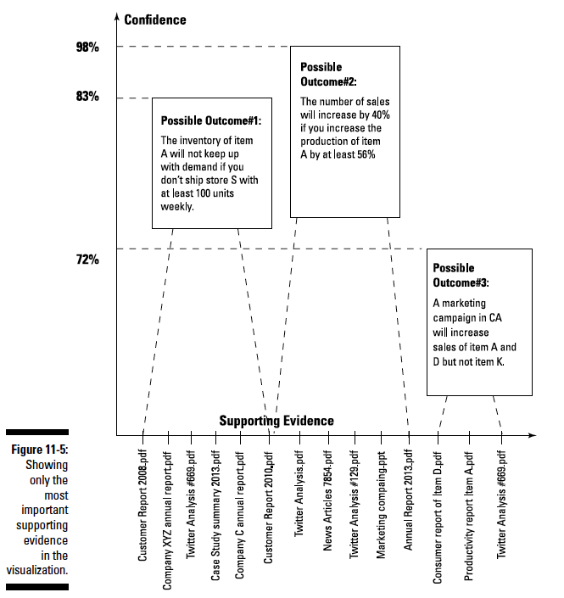

Slide 24
Visual Summary of Predictive Analytics Results
Purpose: Present possible outcomes, confidence scores, and supporting evidence for each scenario.
Important Points:
Scenario 1:
Inventory of Item A won't meet demand if less than 100 units are shipped weekly to Store S.
Confidence Score: 98 percent
Scenario 2:
Increasing Item, A production by at least 56 percent leads to a 40 percent sales increase.
Confidence Score: 83 percent
Scenario 3:
A marketing campaign in California will boost sales for Items A and D, but not for Item K.
Confidence Score: 72 percent

Slide 25
IMPORTANCE
Significance of Confidence Score:
Definition: Likelihood of each scenario occurring based on predictive analytics models.
Ordering: Listed in descending order of likelihood.
Supporting Evidence:
Content Source Analysis: Depicted on the x-axis.
Importance: Represents critical excerpts from multiple sources used for predictive modeling.
Utility: Essential for explaining the reasoning behind a specific scenario and the evidence supporting it.
Power of Visualization:
Simplicity: Condenses complex predictive analytics into a single, impactful visual.
Impact: Enables effective discussions and facilitates "aha" moments for decision-makers.
Meeting Presentation: Empowers impactful discussions with decision-makers through a concise one-slide visualization.

Slide 26
Other Types of Visualizations in Predictive Analytics
Simulation Through Visualization:
What-If Scenarios: Visualizations can portray simulated scenarios answering "what-if" questions. For instance:
Impact Analysis: Predict the consequences if the company ceases Product D's manufacturing or in case of a natural disaster hitting the home office.
Market Dynamics: Predict outcomes if customer interest wanes in a specific product.
Future Behavior Modeling: Visualizations simulate the future behavior of entities like companies, markets, weather systems, etc.
Dashboard in Predictive Analytics:
Comprehensive Visualization: A dashboard is a visualization tool that offers a comprehensive view of a predictive analytics model.
Interactive Control: It allows users to interact by using control buttons to modify various steps in the predictive analytics pipeline:
Data Selection: Choose specific data sets for analysis.
Data Preprocessing: Modify how data is cleaned or processed.
Model Selection: Switch between different predictive models.
Evaluation Versions: Select and compare different evaluation versions.
Real-time Modifications: The dashboard enables real-time changes to any part of the predictive analytics pipeline, providing flexibility and adaptability.
Dynamic Nature of Dashboards:
Interactivity: Dashboards are interactive visualizations where users have control.
Dynamic Display: Charts, graphs, tables, and maps change dynamically based on user inputs and selections.
Tailored Analyses: Users can customize the displayed information based on their chosen inputs, allowing for tailored analyses and insights.

Slide 27
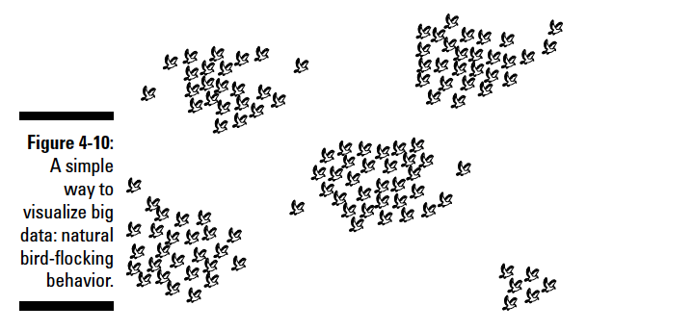
Flocking birds representation
Flock-mates are birds located with a certain distance from each other; those birds are considered similar.
Each bird moves according to the three main rules that organize flocking behavior.
Separation: Flock-mates must not collide with each other.
Alignment: Flock-mates to move in the same average direction as their neighbors.
Cohesion: Flock-mates move according to the average position or location of their flock-mates.
Notes:
Modeling those three rules can enable an analytical system to simulate flocking
behaviors. That’s because biologically inspired algorithms, in particular
those derived from bird-flocking behavior, offer a simple way to model social
network data. Using the self-organized natural behavior of flocking birds,
you can convert a straightforward spreadsheet into a visualization such
as Figure 4-10.
The key is to define the notion of similarity as part of your
data — and construct a mathematical function that supports that similarity.
Start with a couple of questions:
✓ What makes two data objects in your data similar?
✓ Which attributes can best drive the similarity between two data records?
For instance, in social network data, the data records represent individual
users; the attributes that describe them can include Age, Zip Code, Relationship
Status, List of Friends, Number of Friends, Habits, Events Attended, Books Read,
and other groups of particular interests (Sports, Movies, and so on).
You can define the similarity for your group according to nearly any attribute.
For example, you can call two members of a social network similar if they read
the same books, have a large number of common friends, and have attended
the same events. Those two similar members will flock together if they’re
represented by birds flocking in a virtual space.

Slide 28
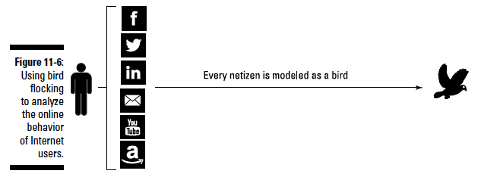
Bird-flocking behaviour data visualization

Slide 29
Bird-flocking behaviour data visualization
The model represents data objects as birds flying in a virtual space, following flocking rules that orchestrate how a migrating swarm of birds moves in nature.
Representing several data objects as birds reveals that similar data objects will flock together to form sub flocks (groupings).
The similarity among objects in the real world is what drives the movements of the corresponding birds in the virtual space.
For instance, as shown in Figure 11-6, imagine that you want to analyze the online data collected from several Internet users (also known as netizens).
Every piece of information (gleaned from such sources as social network user information, customer online transactions, and so on) will be represented as a corresponding bird in the virtual space, as shown in Figure 11-7.

Slide 30
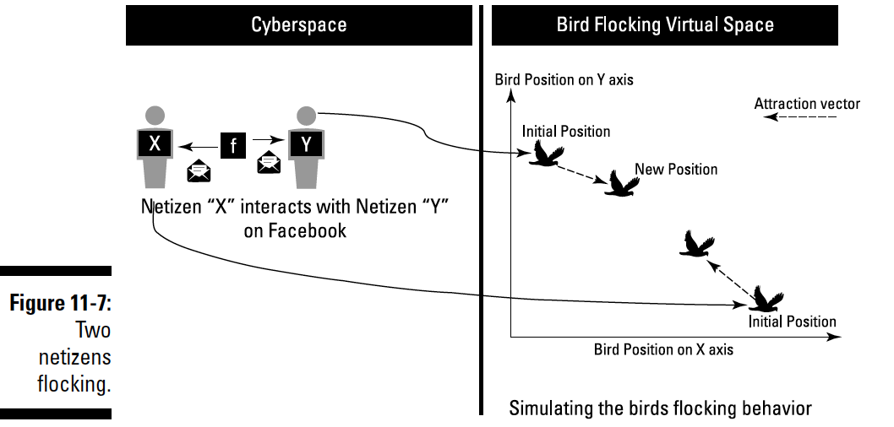

Slide 31
Bird-flocking behaviour data visualization
✓ Data flock homogeneity: Members of the flock show similarity in data.
✓ Data flock leadership: The model anticipates information leaders.
In Figure 11-8, a visualization based on flocking behavior starts by indexing
each netizen to a virtual bird. Initially, all the birds are idle. As data comes
in, each bird starts flocking in the virtual space according to the analytics
results and the flocking rules.

Slide 32
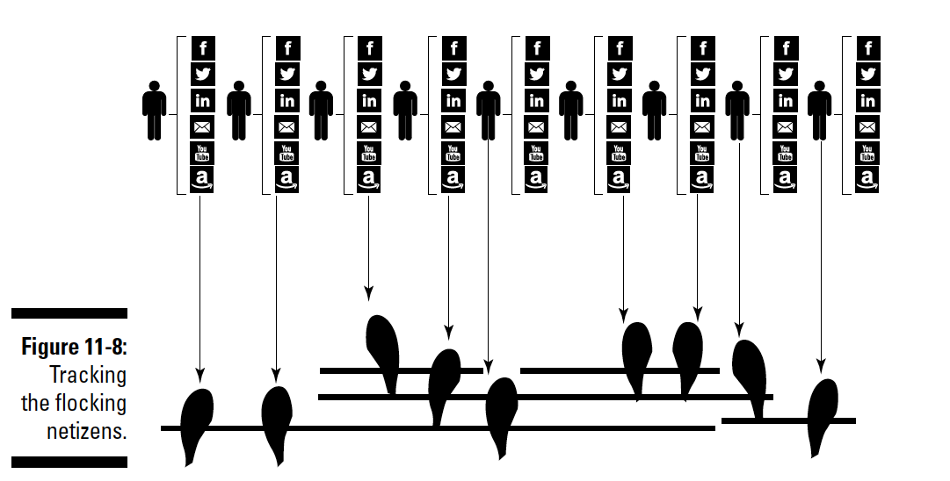

Slide 33
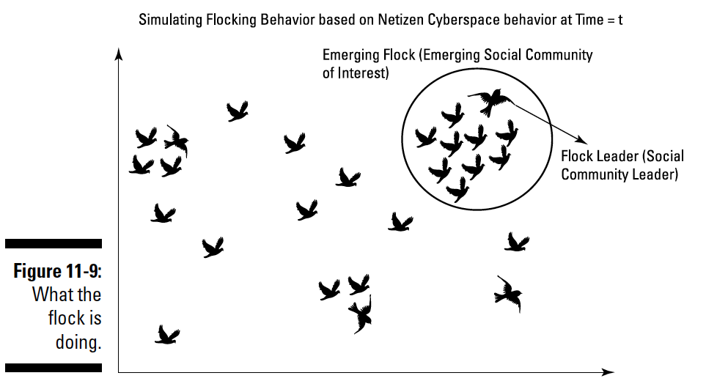
In Figure 11-9, the emerging flock is formed as the analytics are presented.

Slide 34
SUB DIVIDED FLOCK
After analyzing data over a large period of time ending at t+k, the results of this application of predictive analytics results can be depicted as shown in Figure 11-10:
The flock-by-leader algorithm differentiates the members of the flock into three classes: a leader, followers, and outliers.

Slide 35
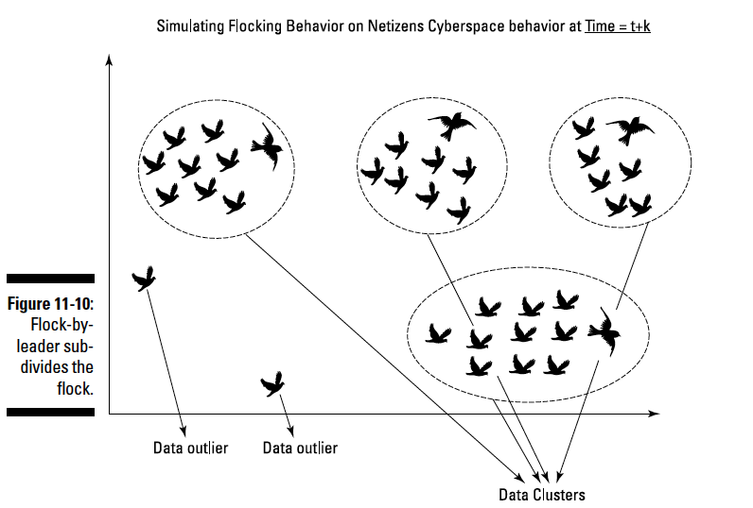
SUB DIVIDED FLOCK

